Slide 1
2019/2020 CISC7201 INTRODUCTION TO DATA SCIENCE PROGRAMMING
Project
Movie Analyzation
Group C
MB955048 Chao Lok Kio Vicky
MB955464 Lei Sin Ian Fio
MB955473 Tou Ka Him Henry

Slide 2
Content
Introduction
Data Source
Python Libraries
Procedure
Result
Future Study

Slide 3
Introduction
Finding out the behaviour of Movie selection through analyzing the past data

Slide 4
Data Source
Data Source from Kaggle:
movies_metadata.csv https://www.kaggle.com/rounakbanik/the-movies-dataset

Slide 5
Python Libraries
Numpy: the fundamental package for scientific computing
Pandas: an open source, BSD-licensed library providing high-performance, easy-to-use data structures and data analysis tools for the Python programming language
Matplotlib.pyplot: a state-based interface to matplotlib and provides a MATLAB-like way of plotting

Slide 6
Python Libraries
Ast (Literal_eval): used for safely evaluating strings containing Python expressions from untrusted sources without the need to parse the values oneself
Seaborn: a visualization library based on matplotlib, provides a high-level interface for statistical graphs
Plotly: known for developing and providing online analytics, statistics and graphing tools

Slide 7
Procedures
Import
Data
Data Cleaning
Result
Analysis

Slide 8
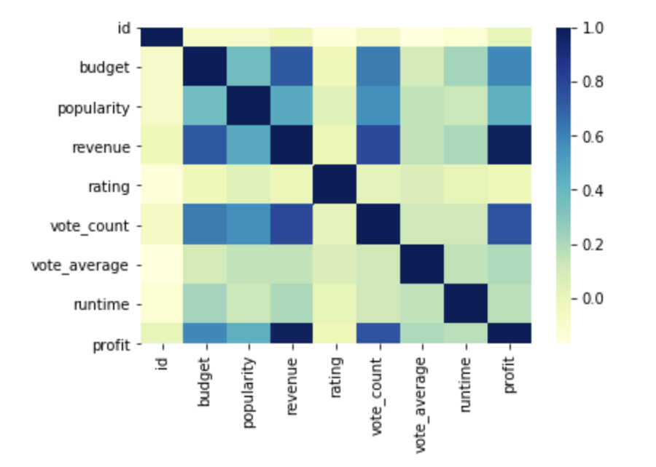
Result
Correlations

Slide 9
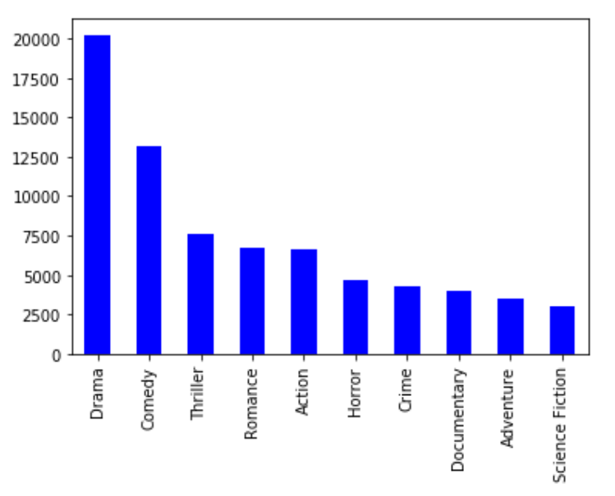
Result
TOP 10 movie Type:

Slide 10
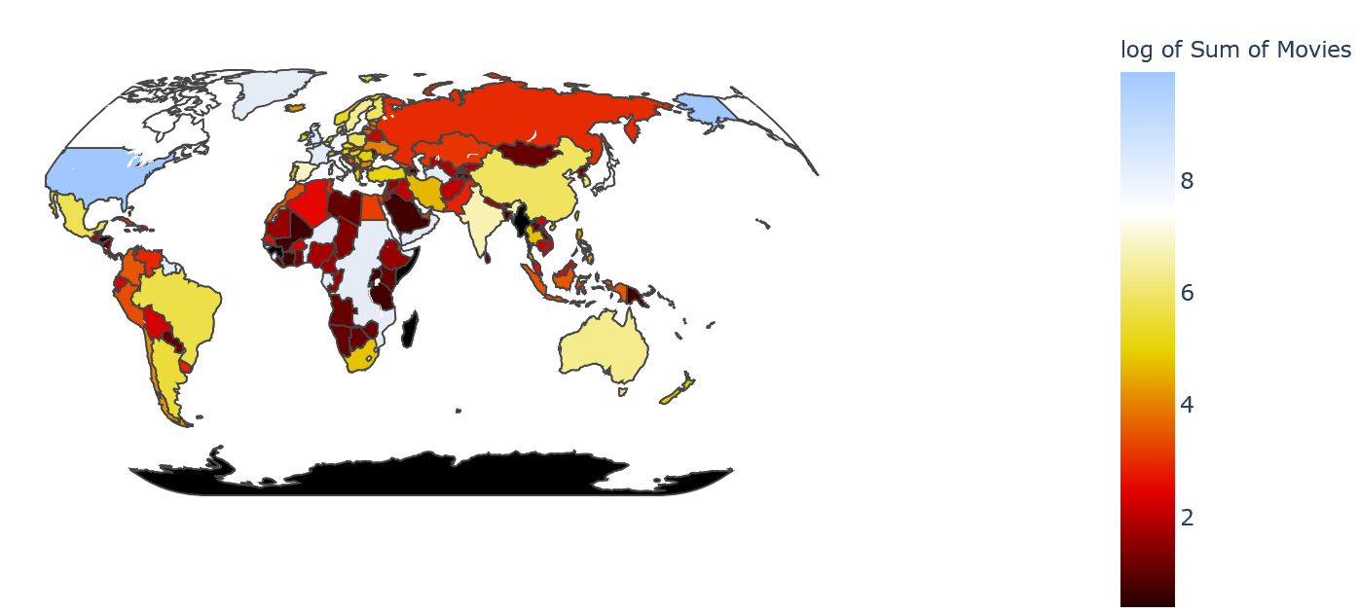
Result
Movie around the world:

Slide 11
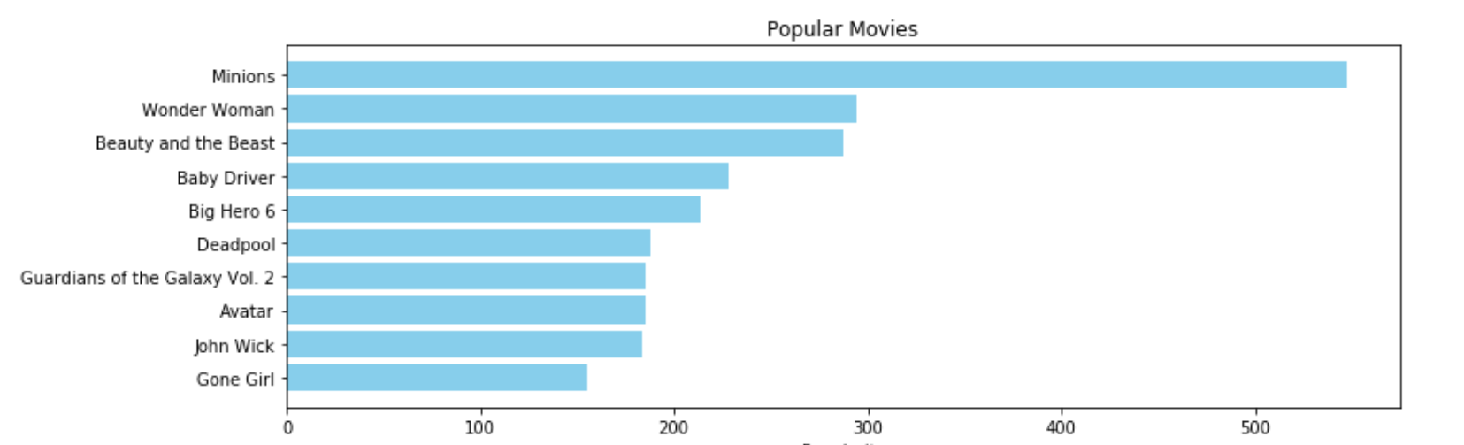
Result
Top 10 popular movies:

Slide 12
Future Study
Base on the result and analysis, we can
Keep update the live Data
Deep Learning the Data
Make Suggestion for the Movie Selection

Slide 13
Q&A
Thank you

